Slide 1
3GPP TR 36.885 v14.0.0 3rd Generation Partnership Project;
Technical Specification Group Radio Access Network;
Study on LTE-based V2X Services;
(Release 14) PC5-based V2V, V2I Channel model Urban case
September. 15. 2021
Donghee Han
dhh0425@sogang.ac.kr

Slide 2
Contents
Terminology & Scenario
Environment parameter
Simulation Block diagram(Urban case)
Geometric parameter(Urban case)
Simulation(Urban case)
ANALYSYS
Future research plan
Development Environment
Reference

Slide 3
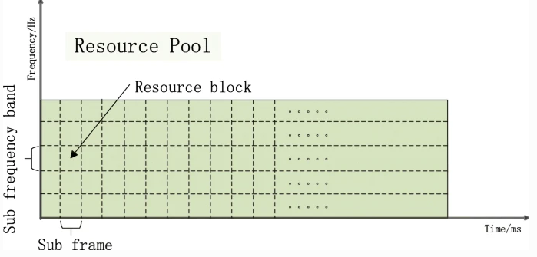
Terminology & Scenario
■ PC5 : 이동 핸드세트가 무선 채널을 통해 다른 UE와 직접 통신하는 인터페이스.
(C-V2X에서 PC5 인터페이스는 V2V 및 V2I의 직접 통신으로 사용.)
■ Sidelink(SL): 단말로부터의 단말로의 통신 Link.
■ V2V operation : Vehicle to Vehicle 통신.
■ V2I operation : Vehicle to Infrastructure 통신.
■ V2P operation : Vehicle to pedestrian 통신.
■ macro eNB(evolved Node B) : 도시 지역의 이동성과 시골 지역의 장거리 도달에 대한 유비쿼터스 커버리지를 제공하는 기지국.
■ Resource pool : PC5 인터페이스로 전송 가능한 Time, Frequency domain의 리소스 집합.
Resource pool

Slide 4
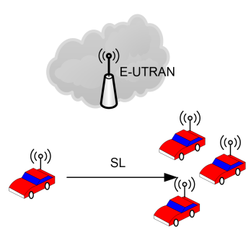
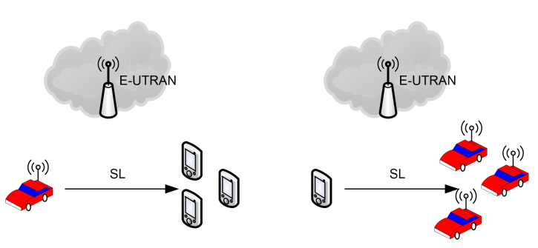
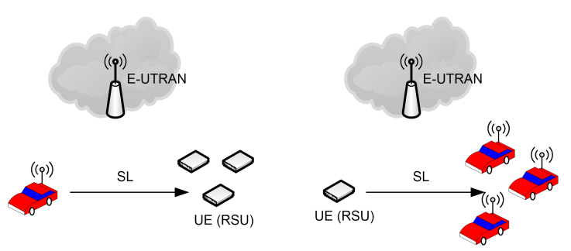
Terminology & Scenario
Scenario1
V2V operation
V2P operation
V2I operation

Slide 5
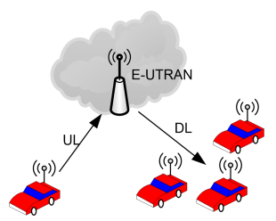
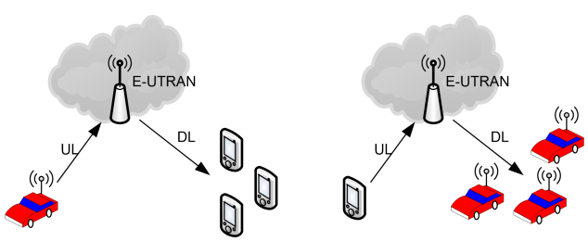
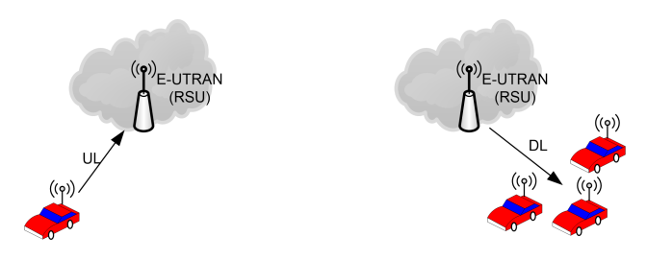
Terminology & Scenario
Scenario2
V2V operation
V2P operation
V2I operation

Slide 6
Environment parameter
Parameter |  | Assumption
Carrier frequency |  | - PC5 based V2V : 6 GHz, 2 GHz - V2I : 6GHz (Baseline) for UE type (RSU), 2GHz for eNB type RSU
Bandwidth |  | - PC5 based V2V : 10 MHz - V2I : 10MHz for UE type RSU, 10MHz for each of Down link and Up link in FDD, 20MHz in TDD for eNB type RSU - V2P : 10 MHz is baseline
Number of carriers |  | - One carrier is baseline
Vehicle UE, UE type RSU, Pedestrain UE paraters | Antenna height | -1.5m for vehicle UE and pedestrain UE - 5 m for UE type RSU
 | Antenna gain | - 3 dBi for vehicle UE and UE type RSU - 0 dBi for pedestrain UI
 | Maximum transmit power | 23 dBm
 | Noise figure | 9 dB
Notes:
3GPP TR 36.885 V14.0.0 (2016-06) p62
Table A.1.1-1: Details of evaluation scenarios

Slide 7
Simulation Block diagram(Urban case)
Create
Road
Vehicle-to-vehicle channels are updated during the simulation as follows:
- Let N be the number of vehicle UE in system simulation
- Initialization (at time 0)
- N vehicle locations are generated per agreed drop model
- PL (0) – NxN matrix generated as per vehicle locations and agreed channel models
- Shadowing (in log domain): S(0) – NxN i.i.d. (with the exception that
shadowing between two vehicles should be the same in the two
directions) normal matrix generated as per agreed shadowing model
- Fading (0) – NxN i.i.d. processes with a common distribution
- Update (at time 100*n ms)
- Vehicle locations are updated as per agreed update rules
- PL(n) – N x N matrix generated as per updated vehicle locations
- S(n) = exp(-D/D_corr) .* S(n-1) +sqrt{ (1-exp(-2*D/D_corr))}.*N_S(n)
- where N_S(n) is an NxN i.i.d. (with the exception that shadowing
between two vehicles should be the same in the two directions)
normal matrix generated as per the agreed shadowing model
- D is the update distance matrix where D(i,j) is change in distance of
link i to j from time n-1 to time n
- Fading process is not impacted due to vehicle location updates
(fading is only updated due to time)
- UE performance should reflect fast fading variation within the subframe
Drop vehicle, base station
(position)
- Set vehicle state
(direction, velocity...)
- t = 0 Init / t > 0 Update V2V(Vehicle to Vehicle) link
- NxN matrix
- Large scale fading
- Path loss
- Shadowing
- Small scale fading
- Fast fading
- t = 0 Init / t > 0 Update V2I(Vehicle to Infrastructure) link
- 1XN matrix
- Large scale fading
- Path loss
- Shadowing
- Small scale fading
- Fast fading
Update vehicle position based on vehicle state
Notes:
3GPP TR 36.885 V14.0.0 (2016-06) p68
A.1.4 Channel model

Slide 8
Geometric parameter(Urban case)
Parameter | Urban case
Number of lanes | 2 in each direction (4 lanes in total in eacy street)
Lane width | 3.5m
Road grid size by the distance beetween intersections | 433m * 250m Note that 3 m is reserved for side walk per direction
Simulation area size | Minimum [1299 m * 750 m]
Vehicle density | Average inter-vehicle distance in the same lane is 2.5 sec * absolute vehicle speed. Baseline: The same density/speed in all the lanes in one simulation.
Absolute vehicle speed | 15 km/h, 60 km/h
Notes:
3GPP TR 36.885 V14.0.0 (2016-06) p64
Table A.1.2-1: Details of vehicle UE drop and mobility model

Slide 9
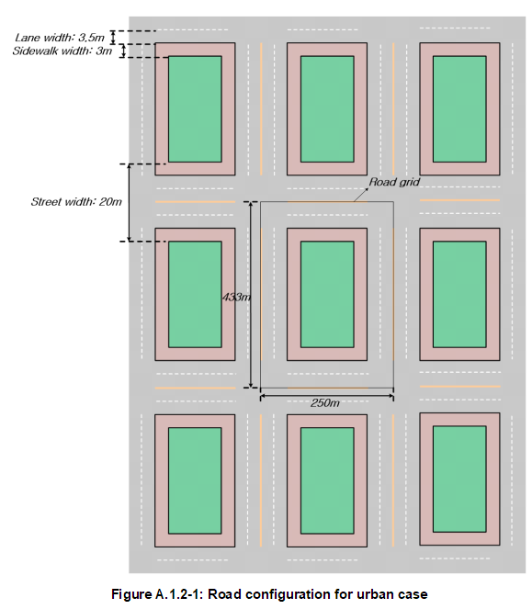
Simulation(Urban case)
Create Road(Urban case)
Notes:
3GPP TR 36.885 V14.0.0 (2016-06) p64
Figure A.1.2-1:Road configuration for urban case

Slide 10
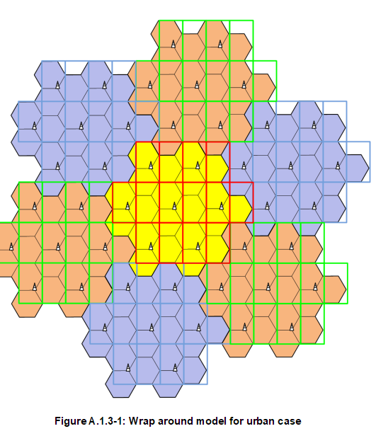
Simulation(Urban case)
Drop vehicle, base station (Urban case)
- Vehicle UEs are dropped on the roads according to spatial Poisson process.
- Vehicle density is determined by the vehicle speed
- macro eNB is 500 m and the wrap around model in
Figure A.1.3-1 is used.
Notes:
3GPP TR 36.885 V14.0.0 (2016-06) p65, p66
Figure A.1.3-1 : Wrap around model for urban case

Slide 11
Simulation(Urban case)
Set vehicle UE’s state
Vehicle No. | Absolute vehicle speed
0 | 15 km/h or 60 km/h
1 | 15 km/h or 60 km/h
... | 15 km/h or 60 km/h
N | 15 km/h or 60 km/h
Notes:
3GPP TR 36.885 V14.0.0 (2016-06) p64
Table A.1.2-1: Details of vehicle UE drop and mobility model

Slide 12
Simulation(Urban case)
Notes:
3GPP TR 36.885 V14.0.0 (2016-06) p64
Table A.1.2-1: Details of vehicle UE drop and mobility model

Slide 13
Simulation(Urban case)
Initialize V2V(Vehicle to Vehicle) link
No. 1
N ：Number of vehicles
R : Number of Resource block
1. Large scale fading
- Shadow fading (NxN matrix)
- Pathloss (NxN matrix)
2. Small scale fading
- Fast fading (NxNxR matrix)
No. 0
No. 2
Notes:
3GPP TR 36.885 V14.0.0 (2016-06) p64
Table A.1.2-1: Details of vehicle UE drop and mobility model

Slide 14
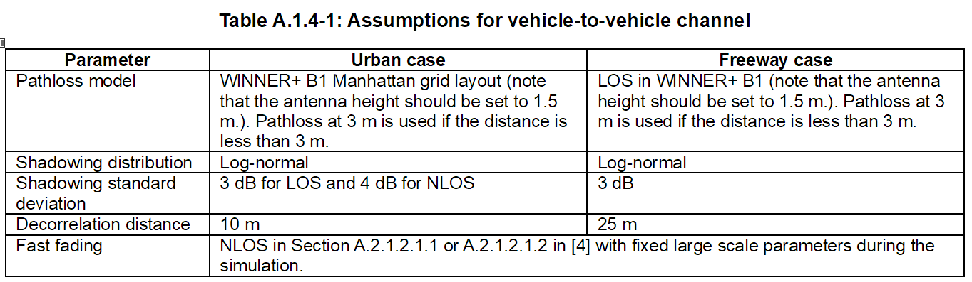
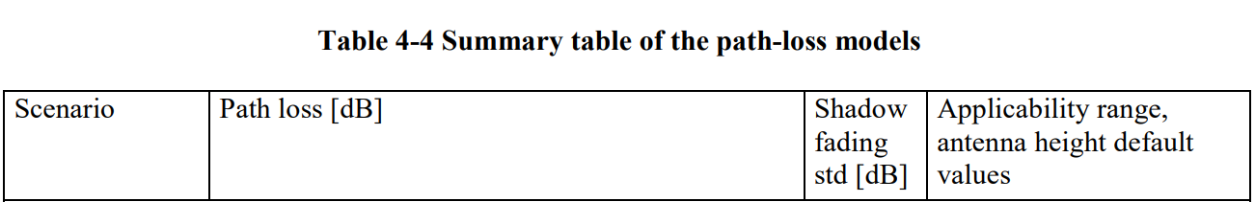
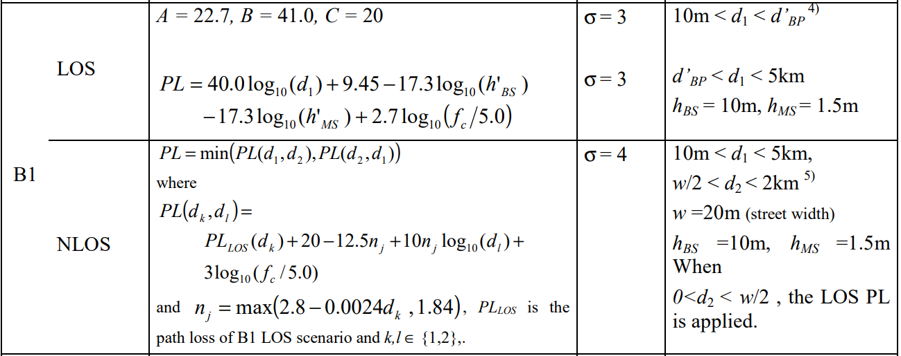
Simulation(Urban case)
Initialize V2V(Vehicle to Vehicle) link
3GPP 36.885
Release 14
WINNER+ B1
Manhattan grid layout
Notes:
3GPP TR 36.885 V14.0.0 (2016-06) p7 Table A.1.4-1: Assumptions for vehicle-to-vehicle channel
WINNER II channel models (Febuary 2008) Page 44 Table 4-4 Summary table of the path-loss models

Slide 15

Simulation(Urban case)
Initialize V2V(Vehicle to Vehicle) link
Large scale fading(N : Number of vehicles )
- Shadow fading (NxN matrix)
$$Shadowing matrix : \left[\begin{matrix}s_{0 0} & ⋯ & s_{0 N} \\ ⋮ & ⋱ & ⋮ \\ s_{N 0} & ⋯ & s_{N N}\end{matrix}\right]$$
$$s_{i j} : i번째 차량에서 j번째 차량으로 전송할때 Shadow fading$$
$${ s}_{i j} \sim ln𝒩(0,σ^{2}), σ = 3dB for LOS or σ = 4dB for LOS$$
Notes:
WINNER II channel models (Febuary 2008) Page 44 Table 4-4 Summary table of the path-loss models

Slide 16
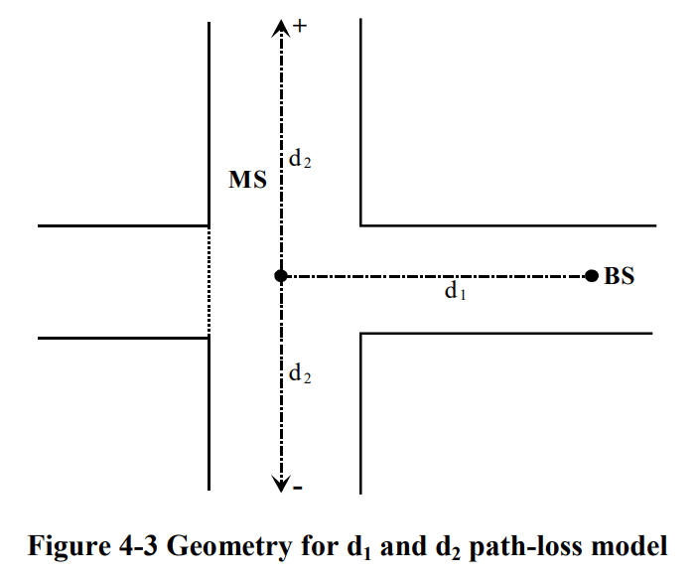

Simulation(Urban case)
Initialize V2V(Vehicle to Vehicle) link
Large scale fading(N : Number of vehicles )
- Pathloss model (NxN matrix)
$$Pathloss matrix : \left[\begin{matrix}p_{0 0} & ⋯ & p_{0 N} \\ ⋮ & ⋱ & ⋮ \\ p_{N 0} & ⋯ & p_{N N}\end{matrix}\right]$$
$$p_{i j} : i번째 차량에서 j번째 차량으로 전송할때 Pathloss$$
$${ p}_{i j} = \left\{\begin{aligned}if LOS(d ≥ 3m){ 40.0log}_{10}(d){+ 9.45−17.3\log_{10}({h′}_{bs}){−17.3\log_{10}({h′}_{ms}){+2.7\log_{10}(f_{c}/5.0){ }}}} \\ if LOS(d < 3m){ 22.7log}_{10}(d){+ 41.0+20\log_{10}(f_{c}/5.0){ }{}} \\ if NLOS min({PL}_{NLOS}(d_{1},d_{2}), {PL}_{NLOS}(d_{1},d_{2})) \end{aligned}\right.$$
$${PL}_{LOS} is the pathloss of LOS scenario and k,l∈\{1,2\}$$
$${{PL}_{NLOS}(d_{k},d_{l}) : PL}_{LOS}(d_{k})+20−12.5n_{j}+10n_{j}\log_{10}(d_{l}){+3\log_{10}(f_{c}/5.0){}}$$
$$n_{j} : max(2.8−0.0024d_{k}, 1.84)$$
$$d : 두차량의 대각 거리$$
$$d1 : 송신 차량에서 교차로 까지 거리$$
$$d2 : 수신 차량에서 교차로 까지 거리$$
$$f_{c} : Carrier frequency$$
$${h′}_{bs} : 송신 차량의 안테나 높이 - 1$$
$${h′}_{ms}: 수신 차량의 안테나 높이 - 1$$
Notes:
WINNER II channel models (Febuary 2008) Page 44 Table 4-4 Summary table of the path-loss models

Slide 17

Simulation(Urban case)
Initialize V2V(Vehicle to Vehicle) link
Small scale fading(N : Number of vehicles , R : Resource block )
- Fast fading (NxNxR matrix)
(Fast fading은 position의 영향을 받지 않음.)
$$Fast fading matrix : \left[\begin{matrix}\left[\begin{aligned}{rb}_{0,0,0} \\ ⋮ \\ {rb}_{0,0,R}\end{aligned}\right] & ⋯ & \left[\begin{aligned}{rb}_{0,N,0} \\ ⋮ \\ {rb}_{0,N,R}\end{aligned}\right] \\ ⋮ & ⋱ & ⋮ \\ \left[\begin{aligned}{rb}_{N,0,0} \\ ⋮ \\ {rb}_{N,0,R}\end{aligned}\right] & ⋯ & \left[\begin{aligned}{rb}_{N,N,0} \\ ⋮ \\ {rb}_{N,N,R}\end{aligned}\right]\end{matrix}\right]$$
$${rb}_{i,j,r} : i번째 vehicle에서$$
$$j 번째 vehicle로$$
$$r번째 resource block을 통해$$
$$신호를 전송할때 발생하는 fast fading 값$$
$$(자기 자신은 0으로 설정)$$
Notes:
3GPP TR 36.843 V12.0.1 (2014-03)
YI-HAN XU, CHENG-CHENG YANG, MIN HUA, AND WEN ZHOU “Deep Deterministic Policy Gradient (DDPG)-Based Resource Allocation Scheme for NOMA Vehicular Communications,” Digital Object Identifier 10.1109/ACCESS.2020.2968595 Paper :
- Fast fading을 Reyleigh fading을 사용.
Hao Ye , Student Member, IEEE, Geoffrey Ye Li, Fellow, IEEE, and Biing-Hwang Fred Juang, “Deep Reinforcement Learning Based Resource Allocation for V2V Communications,” IEEE TRANSACTIONS ON VEHICULAR TECHNOLOGY, VOL. 68, NO. 4, APRIL 2019 Paper :
실수부와 허수부를 독립적으로 가우시안 distrubution을 사용.
Reyleigh fading WIKI : https://ko.wikipedia.org/wiki/%EB%A0%88%EC%9D%BC%EB%A6%AC_%ED%8E%98%EC%9D%B4%EB%94%A9

Slide 18
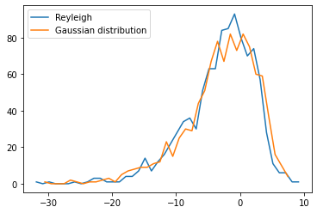


Simulation(Urban case)
Initialize V2V(Vehicle to Vehicle) link
Small scale fading(N : Number of vehicles , R : Resource block )
Fast fading method
1. Deep Reinforcement Learning Based Resource Allocation for V2V Commnunications paper
-> Gaussian distrubution method
2. DDPG-Based Resource Allocation Scheme for NOMA Vehicular Communications paper
-> Reyleigh fading method
$$a \sim 𝒩(0,σ^{2}), σ = 1$$
$$b \sim 𝒩(0,σ^{2}), σ = 1$$
$$Fastfading dBm = 20\log_{10}{\frac{1}{\sqrt{2}}(abs(a + jb))}$$
$$SNR dBm from Reyleigh fading CDFS$$
$$γ ={−\overline{γ}}_{k}(\ln{(1−F_{γ_{k}}\left(x\right))}$$
$$F_{γ_{k}}\left(x\right) : 0 \sim 1 사이의 랜덤 값$$
$${\overline{γ}}_{k} : 평균 SNR dBm$$
Number of
SNR dB
SNR dB
Notes:
3GPP TR 36.843 V12.0.1 (2014-03)
YI-HAN XU, CHENG-CHENG YANG, MIN HUA, AND WEN ZHOU “Deep Deterministic Policy Gradient (DDPG)-Based Resource Allocation Scheme for NOMA Vehicular Communications,” Digital Object Identifier 10.1109/ACCESS.2020.2968595 Paper :
- Fast fading을 Reyleigh fading을 사용.
Hao Ye , Student Member, IEEE, Geoffrey Ye Li, Fellow, IEEE, and Biing-Hwang Fred Juang, “Deep Reinforcement Learning Based Resource Allocation for V2V Communications,” IEEE TRANSACTIONS ON VEHICULAR TECHNOLOGY, VOL. 68, NO. 4, APRIL 2019 Paper :
실수부와 허수부를 독립적으로 가우시안 distrubution을 사용.
Reyleigh fading WIKI : https://ko.wikipedia.org/wiki/%EB%A0%88%EC%9D%BC%EB%A6%AC_%ED%8E%98%EC%9D%B4%EB%94%A9
Jaewoo So, Senior Member, IEEE, “Throughput Analysis of Proportional Fair Scheduling”

Slide 19
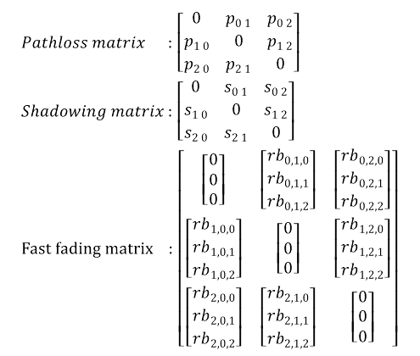


Simulation(Urban case)
Overall V2V(Vehicle to Vehicle) link
Number of vehicles : 3
Resource block: 3
No. 1
$$Pathloss matrix : \left[\begin{matrix}0 & p_{0 1} & p_{0 2} \\ p_{1 0} & 0 & p_{1 2} \\ p_{2 0} & p_{2 1} & 0\end{matrix}\right]$$
$$Shadowing matrix : \left[\begin{matrix}0 & s_{0 1} & s_{0 2} \\ s_{1 0} & 0 & s_{1 2} \\ s_{2 0} & s_{2 1} & 0\end{matrix}\right]$$
$$Fast fading matrix : \left[\begin{matrix}\left[\begin{aligned}0 \\ 0 \\ 0\end{aligned}\right] & \left[\begin{aligned}{rb}_{0,1,0} \\ {rb}_{0,1,1} \\ {rb}_{0,1,2}\end{aligned}\right] & \left[\begin{aligned}{rb}_{0,2,0} \\ {rb}_{0,2,1} \\ {rb}_{0,2,2}\end{aligned}\right] \\ \left[\begin{aligned}{rb}_{1,0,0} \\ {rb}_{1,0,1} \\ {rb}_{1,0,2}\end{aligned}\right] & \left[\begin{aligned}0 \\ 0 \\ 0\end{aligned}\right] & \left[\begin{aligned}{rb}_{1,2,0} \\ {rb}_{1,2,1} \\ {rb}_{1,2,2}\end{aligned}\right] \\ \left[\begin{aligned}{rb}_{2,0,0} \\ {rb}_{2,0,1} \\ {rb}_{2,0,2}\end{aligned}\right] & \left[\begin{aligned}{rb}_{2,1,0} \\ {rb}_{2,1,1} \\ {rb}_{2,1,2}\end{aligned}\right] & \left[\begin{aligned}0 \\ 0 \\ 0\end{aligned}\right]\end{matrix}\right]$$
$$p_{0 1},s_{0 1}, {rb}_{0,1,0}$$
No. 0
$$p_{1,0},{ s}_{1,0}, { rb}_{1,0,1}$$
No. 2

Slide 20
Simulation(Urban case)
Initialize V2I(Vehicle to Infrastructure) link
No. 1
N ：Number of vehicles
R : Number of Resource block
1. Large scale fading
- Shadow fading (N matrix)
- Pathloss (N matrix)
2. Small scale fading
- Fast fading (NxR matrix)
No. 0
No. 2

Slide 21
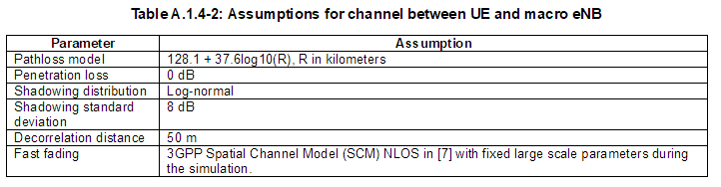
Simulation(Urban case)
Initialize V2I(Vehicle to Infrastructure) link
Notes:
3GPP TR 36.885 V14.0.0 (2016-06) Table A.1.4-2: Assumptions for channel between UE and macro eNB

Slide 22

Simulation(Urban case)
Initialize V2I(Vehicle to Infrastructure) link
Large scale fading(N :차량의 수 )
- Shadow fading (N matrix)
$$Shadowing matrix : \left[\begin{matrix}s_{0} \\ ⋮ \\ s_{N}\end{matrix}\right]$$
$$s_{i } : i번째 차량과 macro eNodeB link에서 생성된 Shadow fading$$
$${ s}_{i } \sim ln𝒩(0,σ^{2}), σ = 8dB$$
Notes:
3GPP TR 36.885 V14.0.0 (2016-06) p7 Table A.1.4-1: Assumptions for vehicle-to-vehicle channel

Slide 23


Simulation(Urban case)
Initialize V2I(Vehicle to Infrastructure) link
Large scale fading(N :차량의 수 )
- Pathloss model (N matrix)
$$Pathloss matrix : \left[\begin{matrix}p_{0} \\ ⋮ \\ p_{N}\end{matrix}\right]$$
$$p_{i j} : i번째 차량과 macro eNodeB간의 link에서 생성된 Pathloss$$
$${ p}_{i j} = { 128.1 + 37.6log}_{10}(d/km){}$$
$$d$$
Notes:
3GPP TR 36.885 V14.0.0 (2016-06) p7 Table A.1.4-1: Assumptions for vehicle-to-vehicle channel

Slide 24

Simulation(Urban case)
Initialize V2I(Vehicle to Infrastructure) link
Small scale fading(N :차량의 수,R : Resource block )
- Fast fading (NxR matrix)
(Fast fading은 position의 영향을 받지 않음.)
1. Deep Reinforcement Learning Based Resource Allocation for V2V Commnunications 논문
-> Gaussian distrubution method(V2V Link와 동일한 계산 공식)
2. DDPG-Based Resource Allocation Scheme for NOMA Vehicular Communications 논문
-> Reyleigh fading method(V2V Link와 동일한 계산 공식)
$$Fast fading matrix : \left[\begin{matrix}{rb}_{0,0} & … & {rb}_{0,R} \\ ⋮ & ⋱ & ⋮ \\ {rb}_{N,0} & … & {rb}_{N,R}\end{matrix}\right]$$
$${rb}_{i,j} : i번째 vehicle에서 j 번째 resource block을 통해$$
$$신호를 전송할때 발생하는 fast fading 값$$
$$(자기 자신은 0으로 설정)$$
Notes:
3GPP TR 36.843 V12.0.1 (2014-03)
YI-HAN XU, CHENG-CHENG YANG, MIN HUA, AND WEN ZHOU “Deep Deterministic Policy Gradient (DDPG)-Based Resource Allocation Scheme for NOMA Vehicular Communications,” Digital Object Identifier 10.1109/ACCESS.2020.2968595 Paper :
- Fast fading을 Reyleigh fading을 사용.
Hao Ye , Student Member, IEEE, Geoffrey Ye Li, Fellow, IEEE, and Biing-Hwang Fred Juang, “Deep Reinforcement Learning Based Resource Allocation for V2V Communications,” IEEE TRANSACTIONS ON VEHICULAR TECHNOLOGY, VOL. 68, NO. 4, APRIL 2019 Paper :
실수부와 허수부를 독립적으로 가우시안 distrubution을 사용.
Reyleigh fading WIKI : https://ko.wikipedia.org/wiki/%EB%A0%88%EC%9D%BC%EB%A6%AC_%ED%8E%98%EC%9D%B4%EB%94%A9

Slide 25

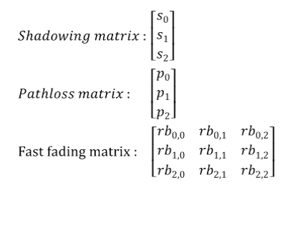
Simulation(Urban case)
Overall V2I(Vehicle to Infrastructure) link
Number of vehicles : 3
Resource block: 3
macro eNodeB : 1
No. 1
$$p_{0 }, s_{0 }, {rb}_{0,1}$$
$$Shadowing matrix : \left[\begin{matrix}s_{0} \\ s_{1} \\ s_{2}\end{matrix}\right]$$
$$Pathloss matrix : \left[\begin{matrix}p_{0} \\ p_{1} \\ p_{2}\end{matrix}\right]$$
$$Fast fading matrix : \left[\begin{matrix}{rb}_{0,0} & {rb}_{0,1} & {rb}_{0,2} \\ {rb}_{1,0} & {rb}_{1,1} & {rb}_{1,2} \\ {rb}_{2,0} & {rb}_{2,1} & {rb}_{2,2}\end{matrix}\right]$$
No. 0
No. 2

Slide 26
Simulation(Urban case)
Update(time step 100ms)
3 차량, 1 macro eNodeB
No. 1
No. 1
No. 0
No. 0
No. 2
No. 2
t0
100ms
t1

Slide 27
Simulation(Urban case)
Update(time step 100ms)
V2V link , V2I link
- Pathloss matrix update
V2V, V2I link에 Initialize 공식
- Fast fading matrix
V2V, V2I link에 Initialize 공식
Notes:
3GPP TR 36.885 V14.0.0 (2016-06)

Slide 28



Simulation(Urban case)
Update(time step 100ms)
V2V link Shadowing matrix
V2I link Shadowing matrix
$$S(n)=e^{\frac{-D}{D_corr}} ×S(n-1)×\sqrt{1-e^{\frac{-2D}{D_corr}}}×N_S(n)$$
$$S\left(n\right) : Next step Shadowing$$
$$D : Delta distance (m)$$
$$D_corr : 10 (m)$$
$$S(n-1) : Current step Shadowing$$
$$N_S(n) : n𝒩(0,σ^{2}), σ = 3dB for LOS or σ = 4dB for LOS$$
$$Delta distance (m)$$
$$S(n)=e^{\frac{-D}{D_corr}} ×S(n-1)×\sqrt{1-e^{\frac{-2D}{D_corr}}}×N_S(n)$$
$$S\left(n\right) : Next step Shadowing$$
$$D : Delta distance (m)$$
$$D_corr : 50 (m)$$
$$S(n-1) : Current step Shadowing$$
$$N_S(n) : n𝒩(0,σ^{2}), σ = 8dB$$
Notes:
3GPP TR 36.885 V14.0.0 (2016-06)

Slide 29
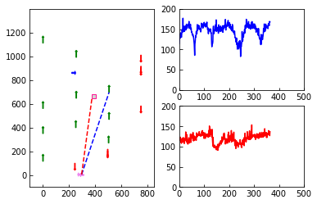
ANALYSYS
Graph description.
Manhattan grid map
loss dB
V2V link combine loss
position Y
MS(Vehicle)
BS
loss dB
V2I link combine loss
1step(100ms)
V2V link
V2I link
MS(Vehicle)
position X
1step(100ms)

Slide 30
ANALYSYS
Compare V2V, V2I link

Slide 31
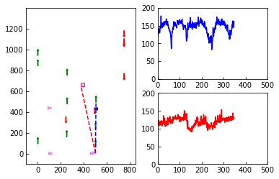

ANALYSYS
Compare V2V, V2I link
두 차량의 거리가 멀어 질수록 V2V Link의 Loss는 증가
기지국과의 거리가 일정함으로 V2I Link는 Loss는 유지

Slide 32
ANALYSYS
Compare V2V, V2I link
두 차량의 거리가 멀어 질수록 V2V Link의 Loss는 증가
기지국과의 거리가 일정함으로 V2I Link는 Loss는 유지

Slide 33
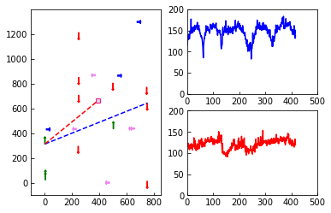
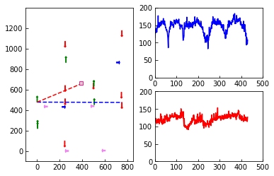
ANALYSYS
Compare V2V, V2I link
두 차량의 V2V Link가 LOS 환경을 만족 시키면
Loss 급격히 감소

Slide 34
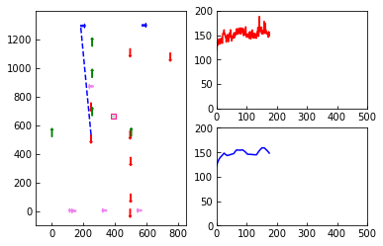
ANALYSYS
Analysis of the effect of WINNER Path loss description.
Manhattan grid map
loss dB
V2V link combine loss
position Y
MS(Vehicle)
V2V link
BS
loss dB
V2V link WINNER II Path loss
1step(0.1ms)
MS(Vehicle)
position X
1step(0.1ms)

Slide 35
ANALYSYS
Analysis of the effect of WINNER Path loss.

Slide 36
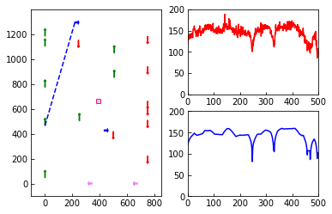
ANALYSYS
Analysis of the effect of WINNER Path loss.
V2V link의 Loss는 Pathloss의 영향이 대부분을 차지함.

Slide 37
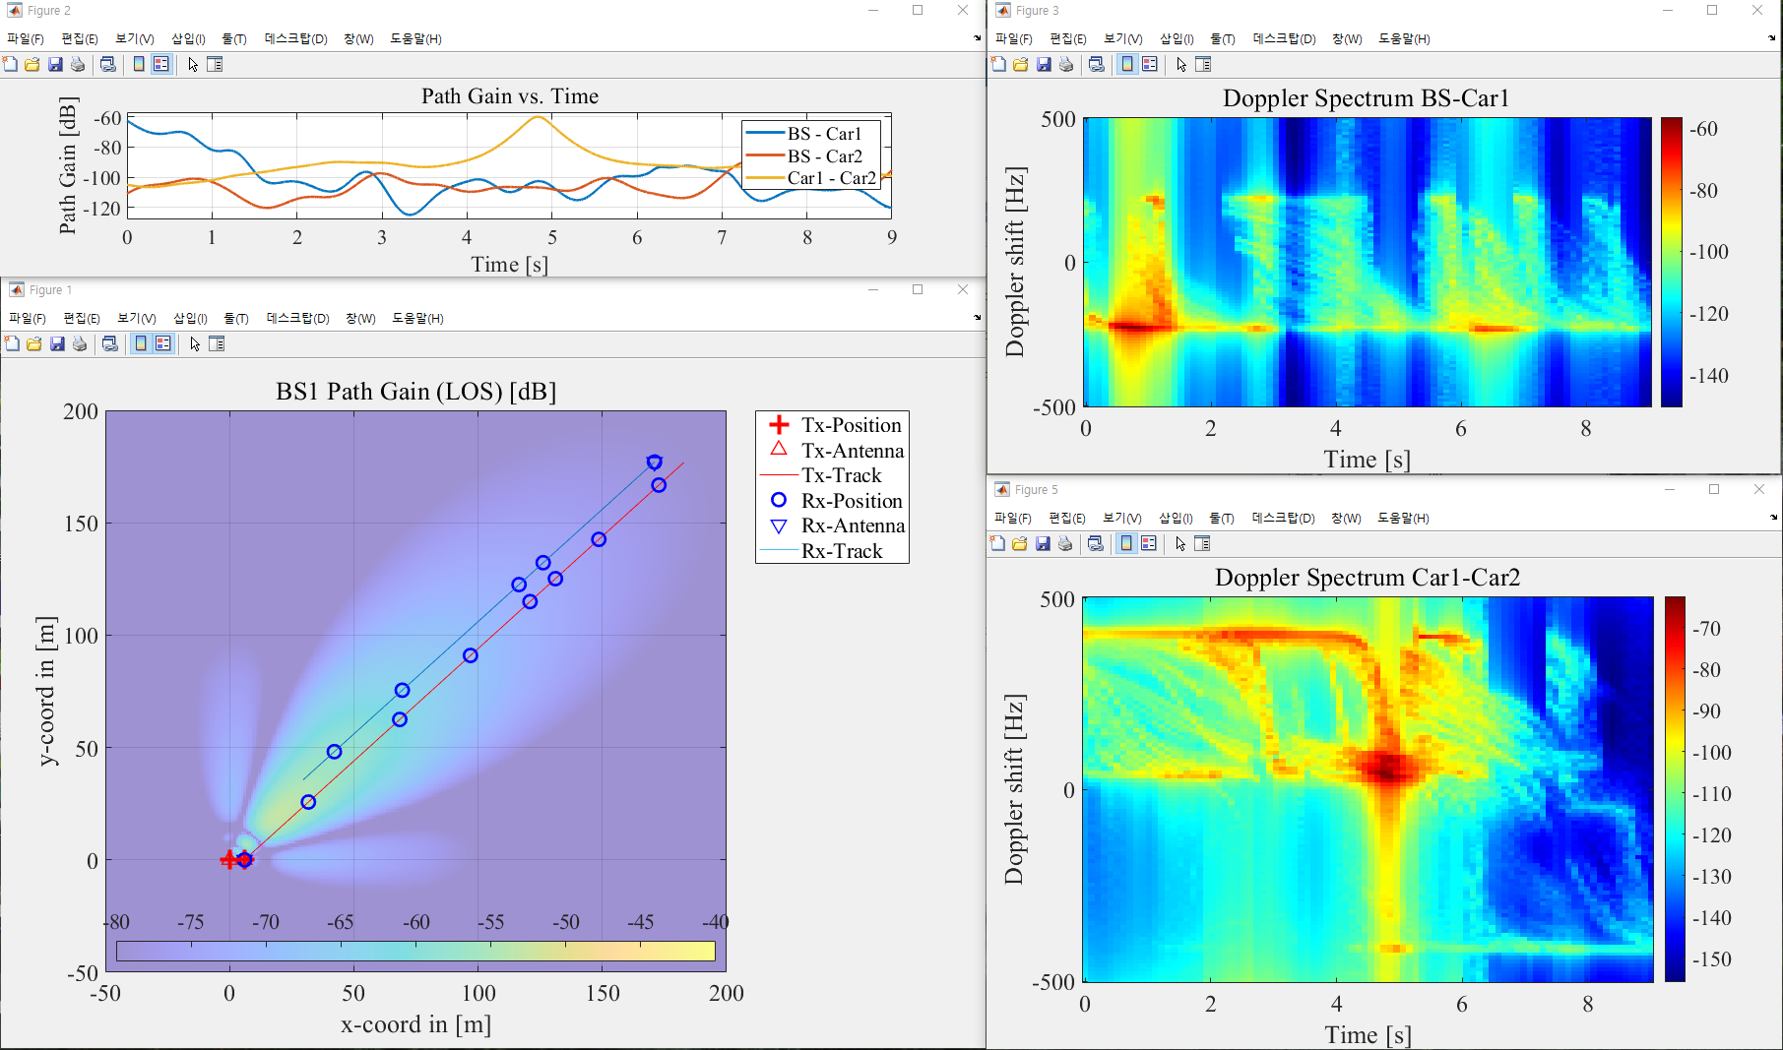
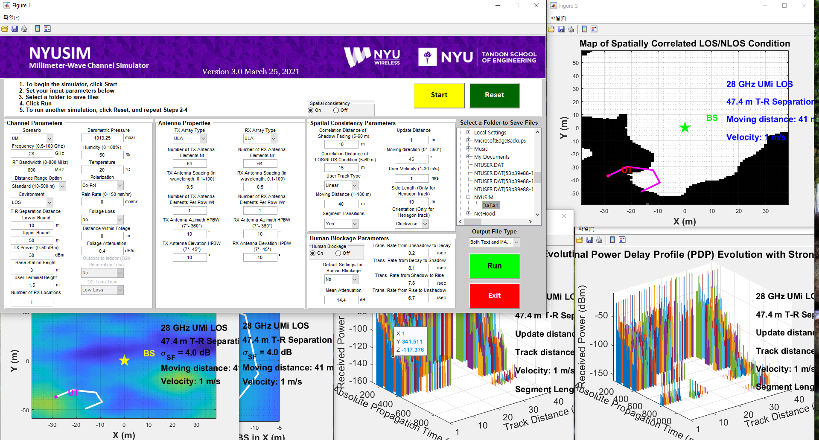
Future research plan
1. Matlab 기반 5G 채널(NYUSIM, QuaDRiGa) 모델 연구.
-> Simulation data 산출
2. DDPG 기반 Resource allocation 연구.
-> System Model 최적화
3. A3C 기반 분산 환경에서 학습 가능한 Resource allocation 연구.
-> System Model 최적화
NYUSIM
QuaDRiGa

Slide 38
Development Environment
Win10 Pro x64
Anaconda
Python 3.7.3 Version
Matplotlib 3.3.4
Numpy 1.19.2

Slide 39
Reference
[1] 3GPP TR 36.885 V14.0.0 (2016-06)
[2] 3GPP TR 36.843 V12.0.1 (2014-03)
[3] 3GPP TR 36.814 V9.2.0 (2017-03)
[4] IST-4-027756 WINNER II D1.1.2 V1.2 WINNER II Channel Models
[5] Hao Ye , Student Member, IEEE, Geoffrey Ye Li, Fellow, IEEE, and Biing-Hwang Fred Juang, “Deep Reinforcement Learning Based Resource Allocation for V2V Communications,” IEEE TRANSACTIONS ON VEHICULAR TECHNOLOGY, VOL. 68, NO. 4, APRIL 2019
[6] YI-HAN XU, CHENG-CHENG YANG, MIN HUA, AND WEN ZHOU “Deep Deterministic Policy Gradient (DDPG)-Based Resource Allocation Scheme for NOMA Vehicular Communications,” Digital Object Identifier 10.1109/ACCESS.2020.2968595
[7] Jaewoo So, Senior Member, IEEE, “Throughput Analysis of Proportional Fair
Scheduling”

